Slide 1
UNIT II
Data Preprocessing:
An Overview, Data Cleaning, Data Integration, Data Reduction, Data Transformation and Data Discretization.

Slide 2
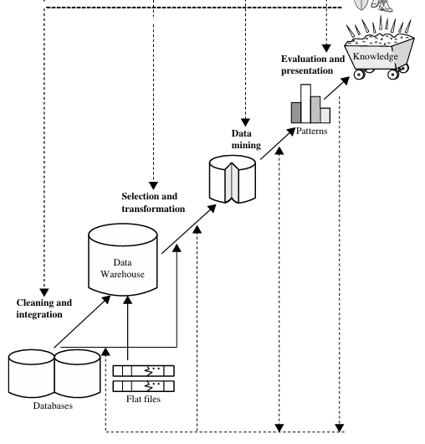
"Data Mining is the process of discovering interesting knowledge, such as patterns, associations, changes, anomalies, and significant structures, from large amounts of data stored in databases, data warehouses, or other information repositories."

Slide 3
The knowledge discovery process is shown in above Fig. as an iterative sequence of the following steps:
1. Data cleaning (to remove noise and inconsistent data)
2. Data integration (where multiple data sources may be combined)
3. Data selection (where data relevant to the analysis task are retrieved from the database)
4. Data transformation (where data are transformed and consolidated into forms appropriate for mining by performing summary or aggregation operations)
5. Data mining (an essential process where intelligent methods are applied to extract data patterns)
6. Pattern evaluation (to identify the truly interesting patterns representing knowledge based on interestingness measures)
7. Knowledge presentation (where visualization and knowledge representation techniques are used to present mined knowledge to users)

Slide 4
Introduction:
Today’s real-world databases are highly susceptible to noisy, missing, and inconsistent data due to their typically huge size and their likely origin from multiple, heterogenous sources.
Low-quality data will lead to low-quality mining results.
How can the data be preprocessed in order to help improve the quality of the data and, consequently, of the mining results?
How can the data be preprocessed so as to improve the efficiency and ease of the mining process?
There are several data preprocessing techniques.
Data cleaning can be applied to remove noise and correct inconsistencies in data.
Data integration merges data from multiple sources into a coherent data store such as a data warehouse.

Slide 5
3. Data reduction can reduce data size by:
Aggregating, eliminating redundant features, or clustering.
4. Data transformations may be applied, where data are scaled to fall within a smaller range like 0.0 to 1.0.
This can improve the accuracy and efficiency of mining algorithms involving distance measurements.
Data Preprocessing: An Overview
Data Quality: Why Preprocess the Data?
Data have quality if they satisfy the requirements of the intended use. There are many factors comprising data quality, including accuracy, completeness, consistency, timeliness, believability, and interpretability.

Slide 6
Suppose you want to analyze AllElectronics with respect to your branch’s sales. You carefully inspect the company’s database and data warehouse, identifying and selecting the attributes or dimensions (e.g., item, price, and units sold) to be included in your analysis.
This scenario illustrates three of the elements defining data quality: accuracy, completeness, and consistency.
Timeliness also affects data quality.
Two other factors:
Believability reflects how much the data are trusted by users, while interpretability reflects how easy the data are understood.

Slide 7
Major Tasks in Data Preprocessing:
Major steps involved in data preprocessing: data cleaning, data integration, data reduction, and data transformation.
Data cleaning: “clean” the data by filling in missing values, smoothing noisy data, identifying or removing outliers, and resolving inconsistencies.
Data integration: involve integrating multiple databases, data cubes, or files.
Data reduction obtains a reduced representation of the data set that is much smaller in volume, yet produces the same (or almost the same) analytical results.
Example strategies: Dimensionality reduction and numerosity reduction.

Slide 8
Dimensionality reduction: “compressed” representation of the original data. Examples include data compression techniques (e.g., wavelet transforms and principal components analysis), attribute subset selection (e.g., removing irrelevant attributes), and attribute construction (e.g., where a small set of more useful attributes is derived from the original set).
Numerosity reduction: The data are replaced by alternative, smaller representations using parametric models (e.g., regression or log-linear models) or nonparametric models (e.g., histograms, clusters, sampling, or data aggregation).
Normalization, data discretization, and concept hierarchy generation are forms of data transformation.

Slide 9
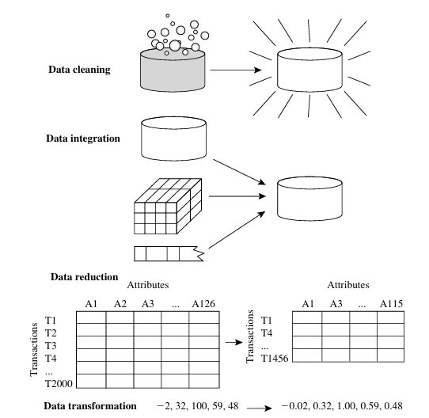

Slide 10
Data cleaning:
Data cleaning routines attempt to fill in missing values, smooth out noise while identifying outliers, and correct inconsistencies in the data.
Missing Values: Ex: Analyze AllElectronics sales and customer data.
If no recorded value for several attributes such as customer income. How can you go about filling.
Ignore the tuple
Fill in the missing value manually
Use a global constant to fill in the missing value
Use a measure of central tendency for the attribute(which indicate the “middle” value of a data distribution. For normal (symmetric)data distributions, the mean can be used, while skewed data distribution should employ the median )
Use the attribute mean or median for all samples belonging to the same class as the given tuple
Use the most probable value to fill in the missing value

Slide 11
Student ID | Name | Marks | Class Label
101 | Ravi | 85 | Pass
102 | Sita | 90 | Missing
A global constant is a single fixed value that is used to replace every missing value in the dataset.
Common examples:
“Unknown”
“N/A”
-∞ (negative infinity)
0 (in some cases)

Slide 12
Suppose customers are classified by Credit Risk.
For Customer C:
Class label = Low Risk
Mean income of Low Risk customers = (50,000 + 60,000) / 2 = 55,000
So the missing value is replaced by 55,000.
Customer | Credit Risk | Income
A | Low | 50,000
B | Low | 60,000
C | Low | Missing
D | High | 20,000
E | High | 25,000

Slide 13
Age | Education | Occupation | Income
30 | Graduate | Engineer | 60,000
45 | Graduate | Manager | 90,000
35 | Graduate | Engineer | Missing

Slide 14
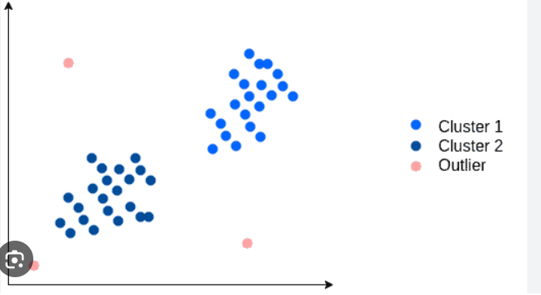
Outliers are data points that significantly deviate from the rest of a dataset. Caused by measurement errors, data corruption, or natural variance.

Slide 15
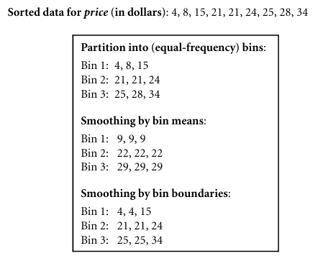
Noisy Data:
Noise is a random error or variance in a measured variable. some basic statistical description techniques (e.g., boxplots and scatter plots), and methods of data visualization can be used to identify outliers, which may represent noise.
What is Data Smoothing?
Data smoothing is the process of removing or reducing noise from data to reveal the underlying pattern.
Binning: Binning methods smooth a sorted data value by consulting its “neighbor hood,” that is, the values around it.

Slide 16
Suppose the actual prices of a product are:
100, 102, 101, 99, 100
but one value is entered incorrectly as:
100, 102, 101, 999, 100

Slide 17
Regression:
Linear regression involves finding the “best” line(Y=mX+C) to fit two attributes so that one attribute can be used to predict the other.
Note: Multiple linear regression is an extension of linear regression, where more than two attributes are involved and the data are fit to a multidimensional surface. (Y=a+b1X1+b2X2+⋯+bnXn​ )
Outlier analysis: Outliers may be detected by clustering, for example, where similar values are organized into groups. Intuitively, values that fall outside of the set of clusters may be considered outliers.
Note: Many data smoothing methods are also used for data discretization (a form of data transformation) and data reduction. A concept hierarchy for price, for example, may map real price values into inexpensive, moderately priced, and expensive, thereby reducing the number of data values to be handled by the mining process.

Slide 18
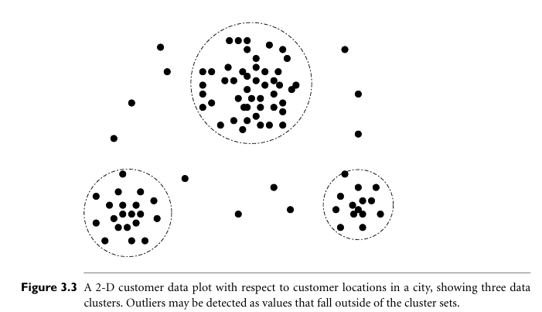

Slide 19
Data Cleaning as a Process
Missing values, noise, and inconsistencies contribute to inaccurate data. So far, we have looked at techniques for handling missing data and for smoothing data.
The first step in data cleaning as a process is discrepancy detection. Discrepancies can be caused by several factors, including poorly designed data entry forms that have many optional fields, human error in data entry, and data decay (e.g., outdated addresses).
Other sources of discrepancies include errors in instrumentation devices that record data and system errors.
Note: Errors can also occur when the data are used for purposes other than originally intended. There may also be inconsistencies due to data integration.

Slide 20
“So, how can we proceed with discrepancy detection?”
As a starting point, use any knowledge you may already have regarding properties of the data (metadata).
For example: we may find noise, outliers, and unusual values with following information:
What are the data type and domain of each attribute?
What are the acceptable values for each attribute?
The basic statistical data descriptions are useful to grasp data trends and identify anomalies.
Are the data symmetric or skewed?
What is the range of values?
Do all values fall within the expected range?
Note:
As a data analyst, you should be on the lookout for the inconsistent use of codes and any inconsistent data representations (e.g., “2010/12/25” and “25/12/2010” for date).
Field overloading is another error source.

Slide 21
The data should also be examined regarding unique rules, consecutive rules, and null rules.
A unique rule says that each value of the given attribute must be different from all other values for that attribute.
A consecutive rule says that there can be no missing values between the lowest and highest values for the attribute, and that all values must also be unique
The null rule should specify how to record the null condition.
Ex: Store zero for numeric attributes, a blank for character attributes, or any other conventions that may be in use (e.g., entries like “don’t know” or “?” should be transformed to blank)
Reasons for missing values may include:
The person originally asked to provide a value for the attribute refuses and/or finds that the information requested is not applicable;
The data entry person does not know the correct value;
The value is to be provided by a later step of the process.

Slide 22
Different commercial tools that can aid in the discrepancy detection step.
Data scrubbing tools use simple domain knowledge to detect errors and make corrections in the data (e.g., knowledge of postal addresses and spell-checking)
Parsing
Parsing means breaking data into smaller components and checking whether they follow the expected format.
Fuzzy Matching
Fuzzy matching identifies values that are similar but not exactly identical.
Data auditing tools find discrepancies by analyzing the data to discover rules and relationships, and detecting data that violate such conditions.
Data migration tools allow simple transformations to be specified such as to replace the string “gender” by “sex.”
ETL(extraction/transformation/loading) tools allow users to specify transforms through a graphical user interface (GUI).

Slide 23
The two-step process of discrepancy detection and data transformation (to correct discrepancies) iterates.
Note: This process is error-prone and time consuming.
Some transformations may introduce more discrepancies. Some nested discrepancies may only be detected after others have been fixed.
For example, a typo such as “20010” in a year field may only surface once all date values have been converted to a uniform format.

Slide 24
Data Integration
Data mining often requires data integration—the merging of data from multiple data stores. Careful integration can help reduce and avoid redundancies and inconsistencies in the resulting data set. This can help improve the accuracy and speed of the subsequent data mining process.
Semantic heterogeneity occurs when different databases use different meanings, formats, names, or representations for the same data. Structural heterogeneity occurs when data is organized differently across various sources. These differences make it difficult to combine data from multiple sources into a unified view.
How can we match schema and objects from different sources..
Are any attributes correlated..
Tuple duplication..
And need to focus on detection and resolution of data value conflicts..

Slide 25
1. Semantic Heterogeneity
Same data has different meanings or names in different databases.
Example:
Database A: Emp_ID
Database B: Employee_Number
2. Structural Heterogeneity
The same information is organized differently in different databases.
Example:
Database A:
Employee(Emp_ID, Name, Department)
Database B:
Employee(Emp_ID, Name)
Department(Dept_ID, Dept_Name)

Slide 26
Issues to consider during data integration:
Entity Identification Problem:
It is the problem of determining whether attributes or records from different data sources refer to the same real-world entity.
How can the data analyst or the computer be sure that customer id in one database and customer number in another refer to the same attribute?
Metadata-Based Matching
Structural Matching and Constraints
When matching attributes from one database to another during integration, special attention must be paid to the structure of the data. This is to ensure that any attribute functional dependencies and referential constraints in the source system match those in the target system.
For example, in one system, a discount may be applied to the order, whereas in another system it is applied to each individual line item within the order. If this is not caught before integration, items in the target system may be improperly discounted.

Slide 27
Redundancy and Correlation Analysis
An attribute (such as annual revenue, for instance) may be redundant if it can be “derived” from another attribute or set of attributes. Inconsistencies in attribute naming can also cause redundancies in the resulting data set.
1. Derived Attribute Redundancy
2. Naming Inconsistency Redundancy
Some redundancies can be detected by correlation analysis. Given two attributes, such analysis can measure how strongly one attribute implies the other, based on the available data.
For nominal data, we use the . For numeric attributes, we can use the correlation coefficient and covariance, both of which access how one attribute’s values vary from those of another.

Slide 28
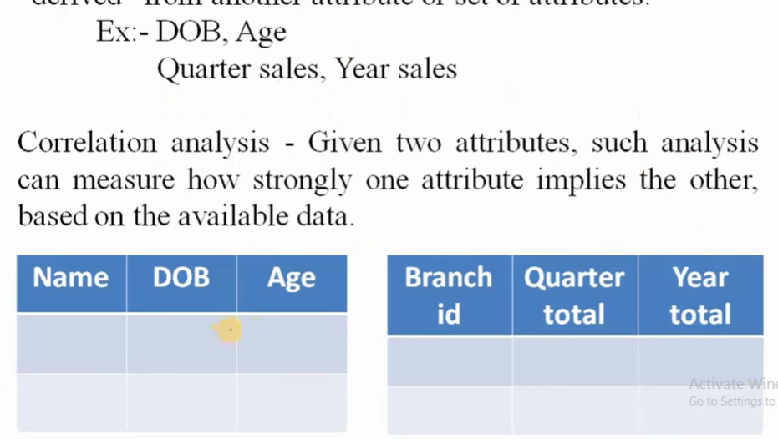

Slide 29

For nominal data, a correlation relationship between two attributes, A and B, can be discovered by a
Suppose A has c distinct values, namely a1,a2, ac. B has r distinct values, namely b1,b2, br. The data tuples described by A and B can be shown as a contingency table, with the c values of A making up the columns and the r values of B making up the rows. Let (Ai, Bj) denote the joint event that attribute A takes on value ai and attribute B takes on value bj, that is, where(A=ai, B=bj). Each and every possible(Ai, Bj) joint event has its own cell (or slot) in the table.
Where oij is the observed frequency (i.e., actual count) of the joint event (Ai, Bj) and eij is the expected frequency of (Ai, Bj), which can be computed as follows:

Slide 30

Where n is the number of data tuples, count(A=ai) is the number of tuples having value ai for A, and count (B=bj) is the number of tuples having value bj for B. The sum in is computed overall of the r x c cells.
Note that the cells that contribute the most to the value are those for which the actual count is very different from that expected.
The statistic tests the hypothesis that A and B are independent, that is, there is no correlation between them. The test is based on a significance level, with (r-1)x(c-1) degrees of freedom. We illustrate the use of this statistic in Example 3.1. If the hypothesis can be rejected, then we say that A and B are statistically correlated.

Slide 31

Suppose that a group of 1500 people was surveyed. The gender of each person was noted. Each person was polled as to whether his or her preferred type of reading material was fiction or nonfiction. Thus, we have two attributes, gender and preferred reading. The observed frequency(or count) of each possible joint event is summarized in the contingency table shown in Table 3.1, where the numbers in parentheses are the expected frequencies.
For example, the expected frequency for the cell(male, fiction) is:

Slide 32
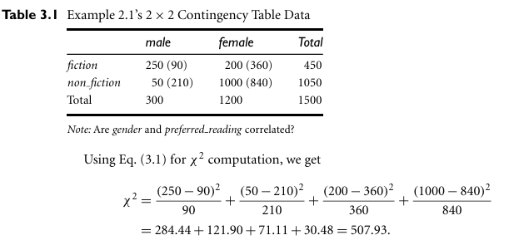

Slide 33

For this 2x2 table, the degrees of freedom are.(2-1)(2-1)=1. For 1 degree of freedom, the chi-square value needed to reject the hypothesis at the 0.001 significance level is10.828.
Since our computed value is above this, we can reject the hypothesis that gender and preferred reading are independent and conclude that the two attributes are (strongly) correlated for the given group of people.
Computed Chi-square value >10.828→null hypothesis is reject(accept alternate hypothesis)→2 variables are not independent.→correlation b/w two variables.
Computed Chi-square value < 10.828→null hypothesis is Accept→2 variables are independent.→ no correlation b/w two variables.
Note:

Slide 34
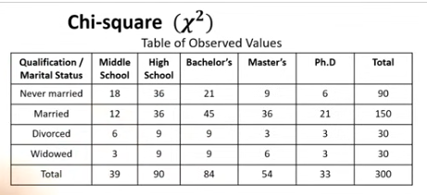
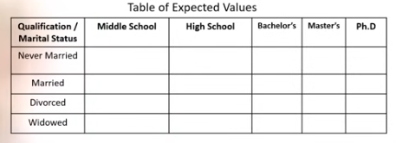

Slide 35
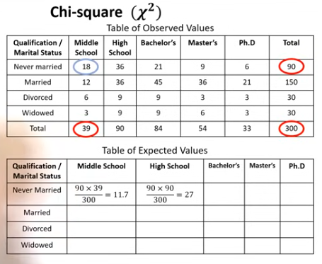

Slide 36
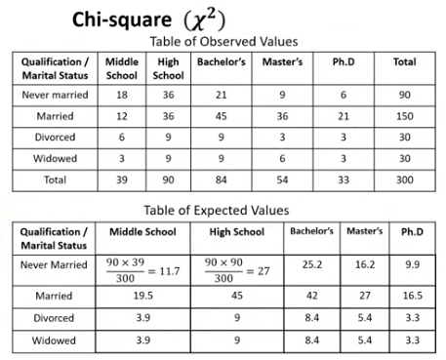

Slide 37

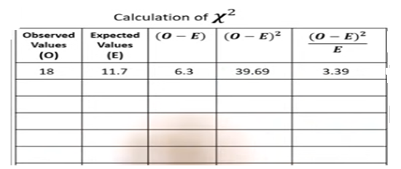

Slide 38
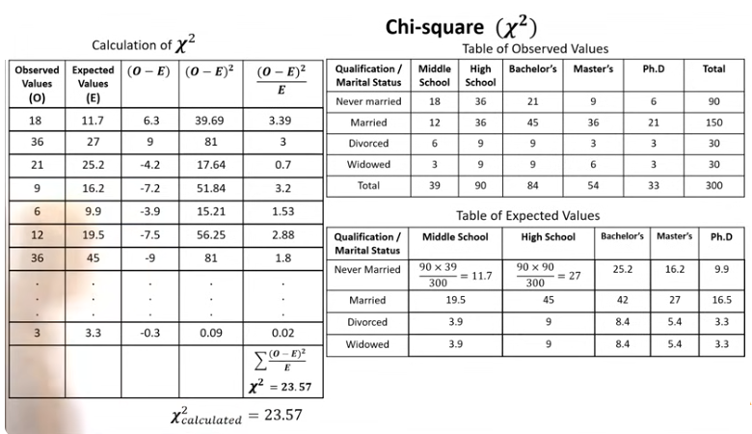

Slide 39
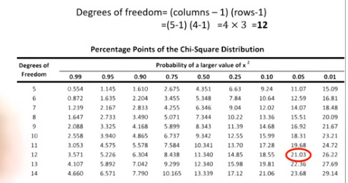
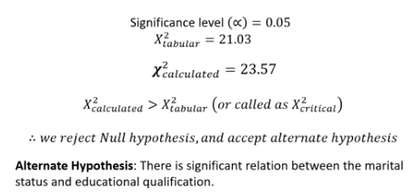

Slide 40
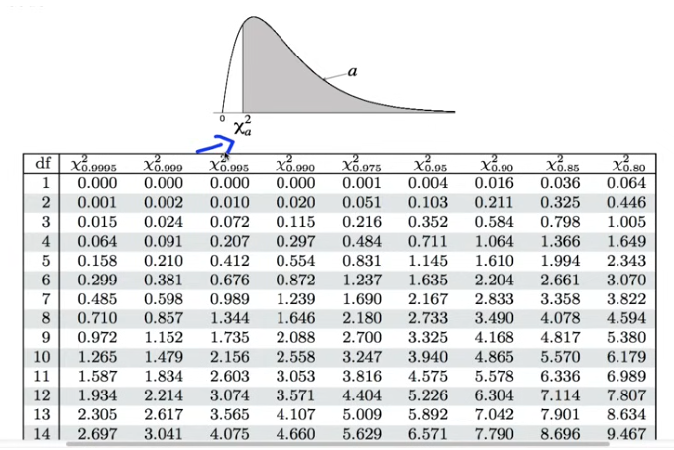

Slide 41
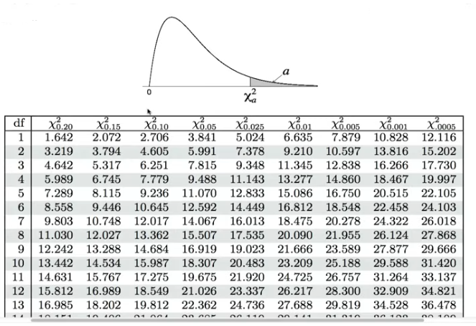

Slide 42

Correlation Coefficient for Numeric Data
For numeric attributes, we can evaluate the correlation between two attributes, A and B, by computing the correlation coefficient (also known as Pearson’s product moment coefficient). That is:
Where n is the number of tuples, a_{i} and b_{i} are the respective values of A and B in tuple i, mean values of A and B, respective standard deviations of A and B, and is the sum of the AB cross-product (i.e., for each tuple, the value for A is multiplied by the value for B in that tuple).
Note: -1 <= r_{A,B} <= +1. If r_{A,B} is greater than 0, then A and B are positively correlated, meaning that the values of A increase as the values of B increase. The higher the value, the stronger the correlation.

Slide 43
If the resulting value is equal to 0, then A and B are independent and there is no correlation between them. If the resulting value is less than 0, then A and B are negatively correlated, where the values of one attribute increase as the values of the other attribute decrease.
Note that correlation does not imply causality. That is, if A and B are correlated, this does not necessarily imply that A causes B or that B causes A.
For example, in analyzing a demographic database, we may find that attributes representing the number of hospitals and the number of car thefts in a region are correlated. This does not mean that one causes the other. Both are actually causally linked to a third attribute, namely, population.

Slide 44
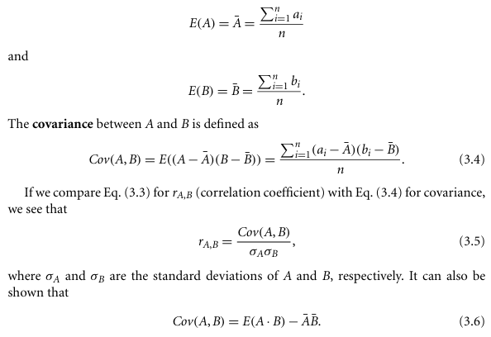
Covariance of Numeric Data
In probability theory and statistics, correlation and covariance are two similar measures for assessing how much two attributes change together. Consider two numeric attributes A and B, and a set of n observations (a1,b1), ,(a_{n},b_{n}) . The mean values of A and B, respectively, are also known as the expected values on A and B. that is:

Slide 45
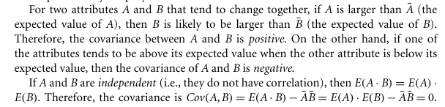
Note: The converse is not true. Some pairs of random variables (attributes) may have a covariance of 0 but are not independent.

Slide 46
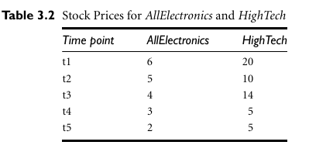
Covariance analysis of numeric attributes:
Consider Table3.2, which presents a simplified example of stock prices observed at five time points for AllElectronics and High Tech, a high-tech company. If the stocks are affected by the same industry trends, will their prices rise or fall together?

Slide 47
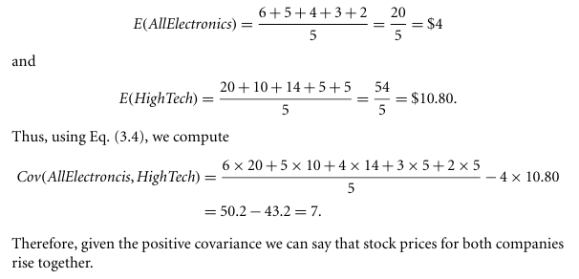

Slide 48
Tuple Duplication:
In addition to detecting redundancies between attributes, duplication should also be detected at the tuple level.
The use of denormalized tables (often done to improve performance by avoiding joins) is another source of data redundancy. Inconsistencies often arise between various duplicates, due to inaccurate data entry or updating some but not all data occurrences.
For example, if a purchase order data base contains attributes for the purchaser’s name and address instead of a key to this information in a purchaser database, discrepancies can occur, such as the same purchaser’s name appearing with different addresses within the purchase order database.

Slide 49
Data Value Conflict Detection and Resolution:
Data integration also involves the detection and resolution of data value conflicts.
For example, for the same real-world entity, attribute values from different sources may differ. This may be due to differences in representation, scaling, or encoding. For instance, a weight attribute may be stored in metric units in one system and British imperial units in another. For a hotel chain, the price of rooms in different cities may involve not only different currencies but also different services (e.g., free breakfast) and taxes.
When exchanging information between schools, for example, each school may have its own curriculum and grading scheme. One university may adopt a quarter system, offer three courses on database systems, and assign grades from A to F, whereas another may adopt a semester system, offer two courses on databases, and assign grades from 1 to 10.

